Slide 1
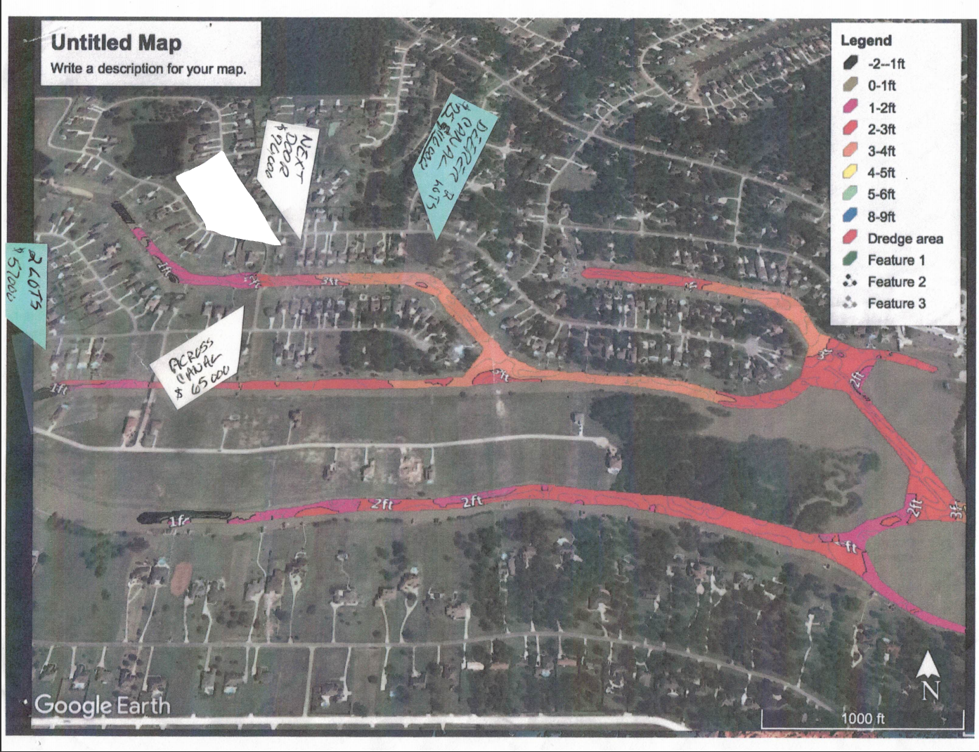
11552 Grand Pine Dr

